Slide 1
UNIT :8 Case Studies
Prepared by
Er.Harendra Bikram Shah
(Lecturer)
Department of computer Engineering

Slide 2
OUTLINES:
Case study of Amazon EC2 cloud
Case study of IBM blue cloud
Case study of Cloud Service: IAAS, PAAS,SAAS

Slide 3
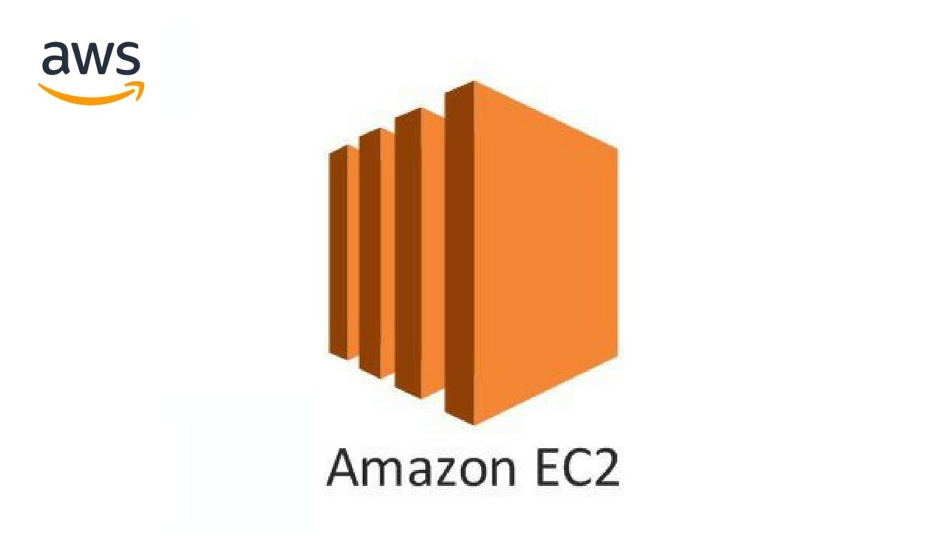
Amazon EC2 cloud
It is a web service interface that provides resizable compute capacity in the AWS cloud.
It is designed for developers to have complete control over web-scaling and computing resources.
In simple word it is a virtual computer which has everything you want to have in a computer.

Slide 4
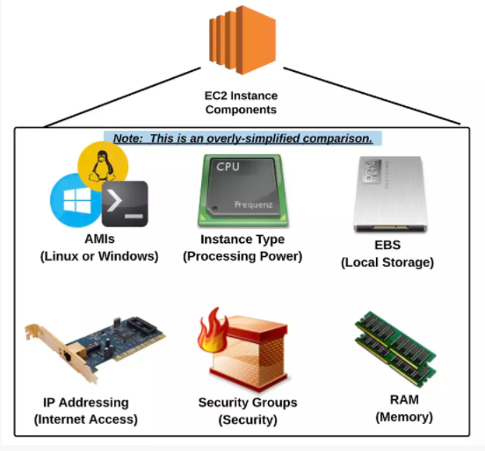

Slide 5
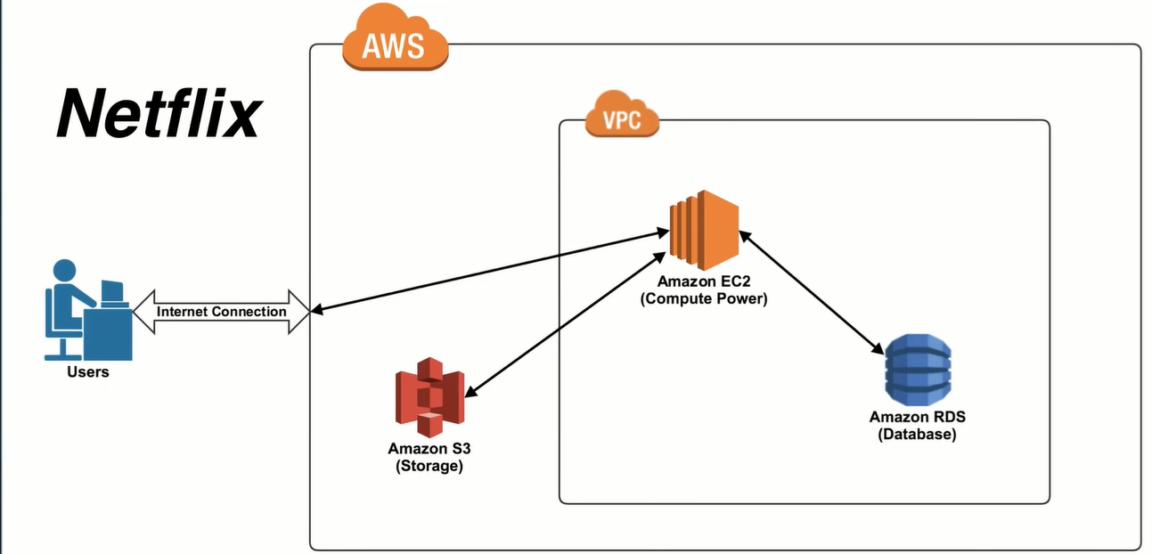
Case study of Amazon EC2 cloud(Netflix)

Slide 6
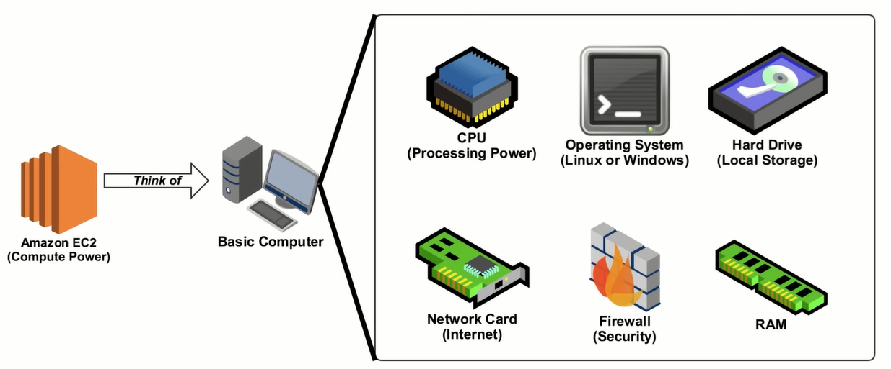

Slide 7
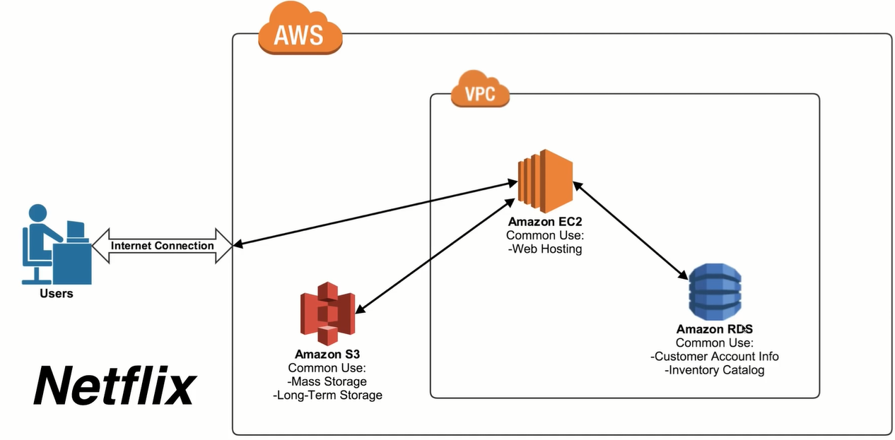

Slide 8
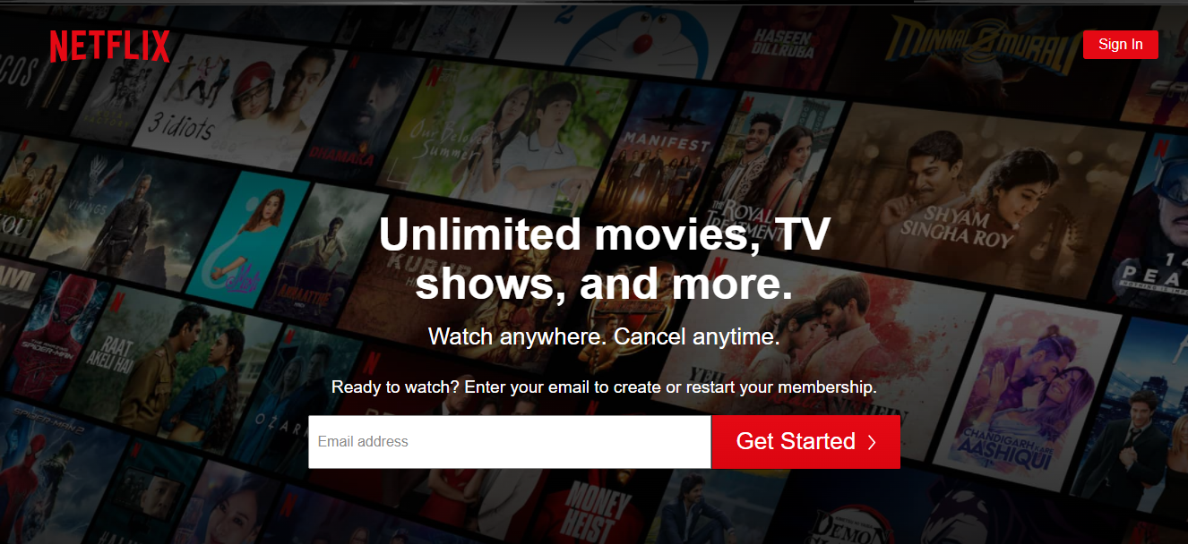

Slide 9
IBM blue cloud
IBM Cloud is IBM’s solution to all the public, private, hybrid cloud & multi-cloud requirements.
It is a PaaS Platform as a service & IaaS Infrastructure as a service solution.
Now IBM cloud is called as IBM Blue Mix Cloud .
SoftLayer Technologies was acquired by IBM in 2013 which is renamed as IBM Bluemix
Further IBM cloud and Bluemix are merged by IBM.
Services Provided by IBM cloud
Application development
Artificial intelligence
Industry
Infrastructure (IT)
Operations
Organization type

Slide 10
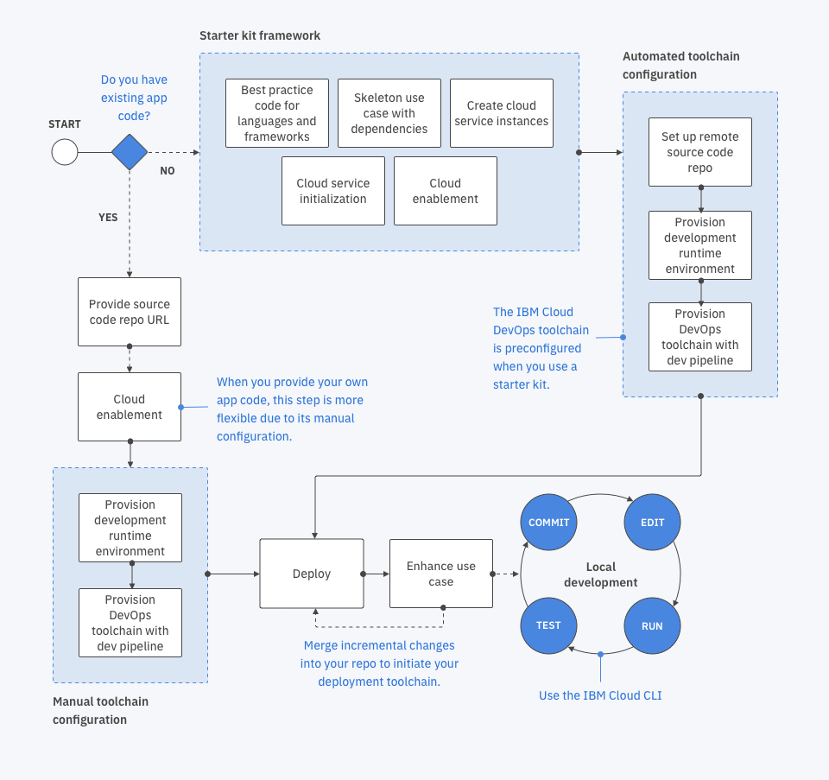
IBM blue cloud Architecture

Slide 11
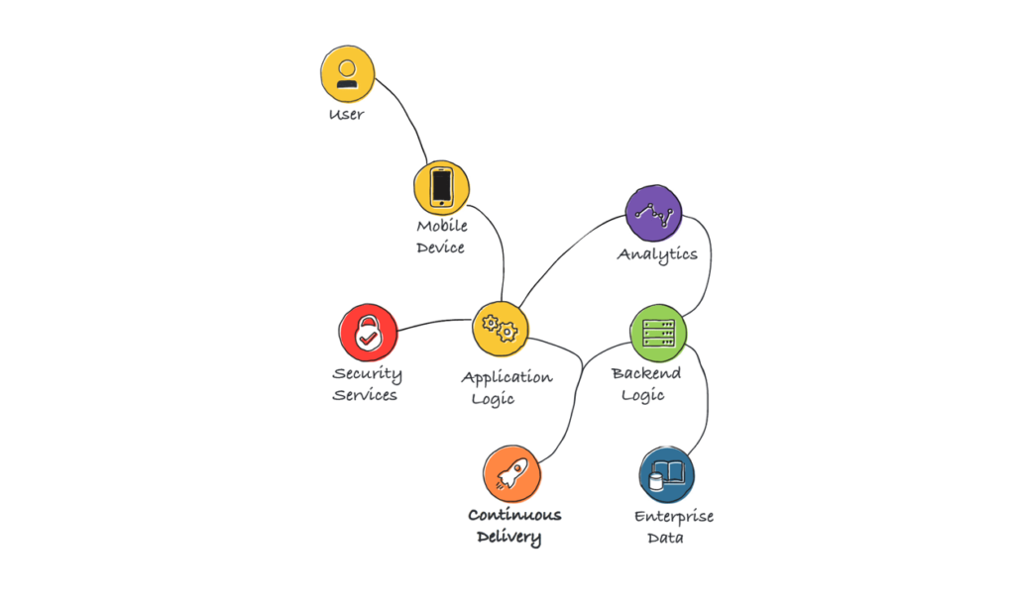
IBM blue cloud Architecture

Slide 12
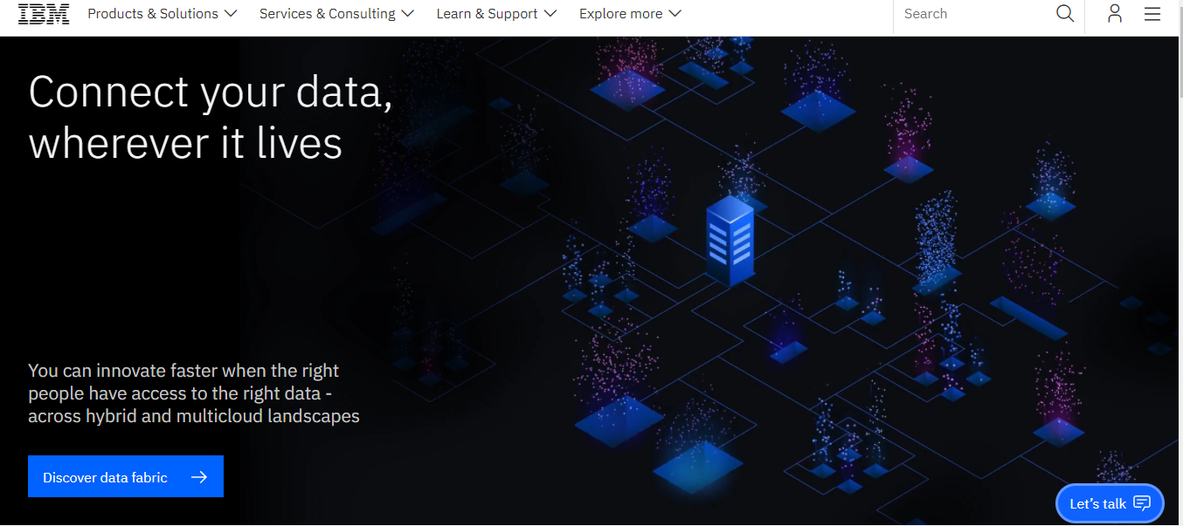

Slide 13
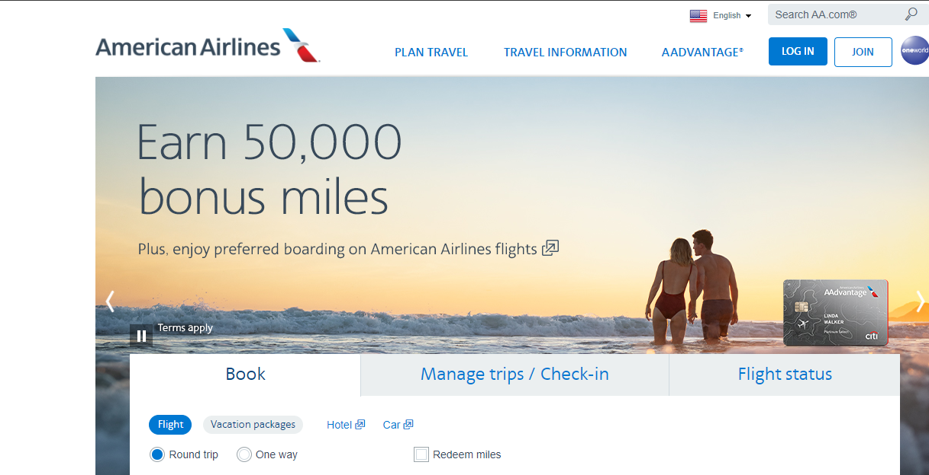
Case study of IBM Blue cloud(American Airlines)

Slide 14
Case study of IAAS,PAAS,SAAS
Platform Type | Common Examples
SaaS | Google Workspace, Dropbox, Salesforce, Cisco WebEx, Concur, GoToMeeting
PaaS | AWS Elastic Beanstalk, Windows Azure, Heroku, Force.com, Google App Engine, Apache Stratos, OpenShift
IaaS | DigitalOcean, Linode, Rackspace, Amazon Web Services (AWS), Cisco Metapod, Microsoft Azure, Google Compute Engine (GCE)
Case study of OLA,NETFLIX

Slide 15
End of the UNIT

Slide 16
End of Syllabus

Slide 17
Presentation session Starts

